Slide 1
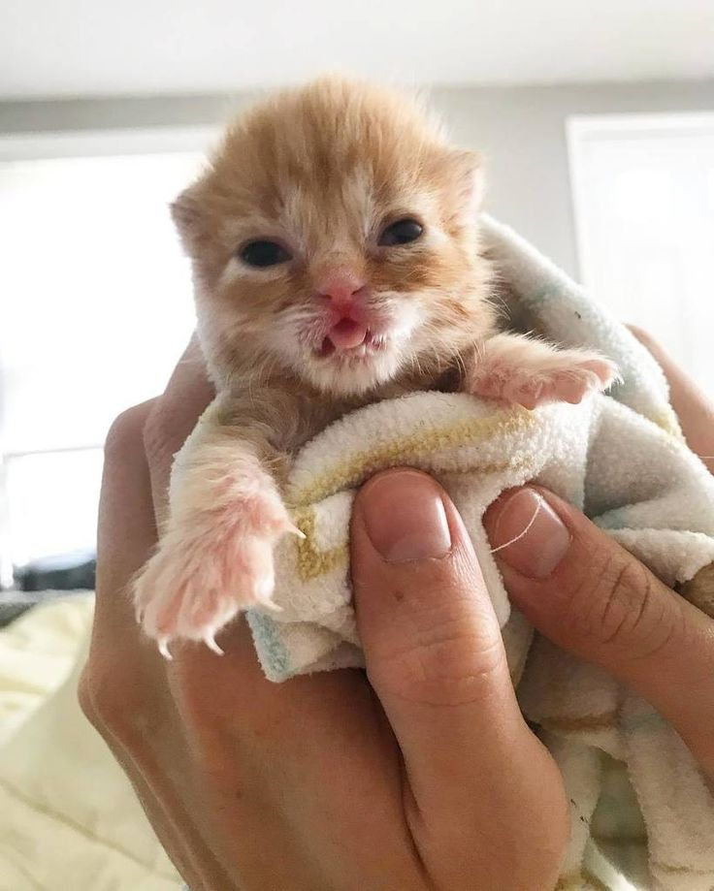
Competitive Cyber Security Organization
General – IR w/Liam (Super Cool and Exciting)
By attending today’s meeting you acknowledge that you may be photographed or recorded for club use

Slide 2

Announcements/Welcome!

Slide 3

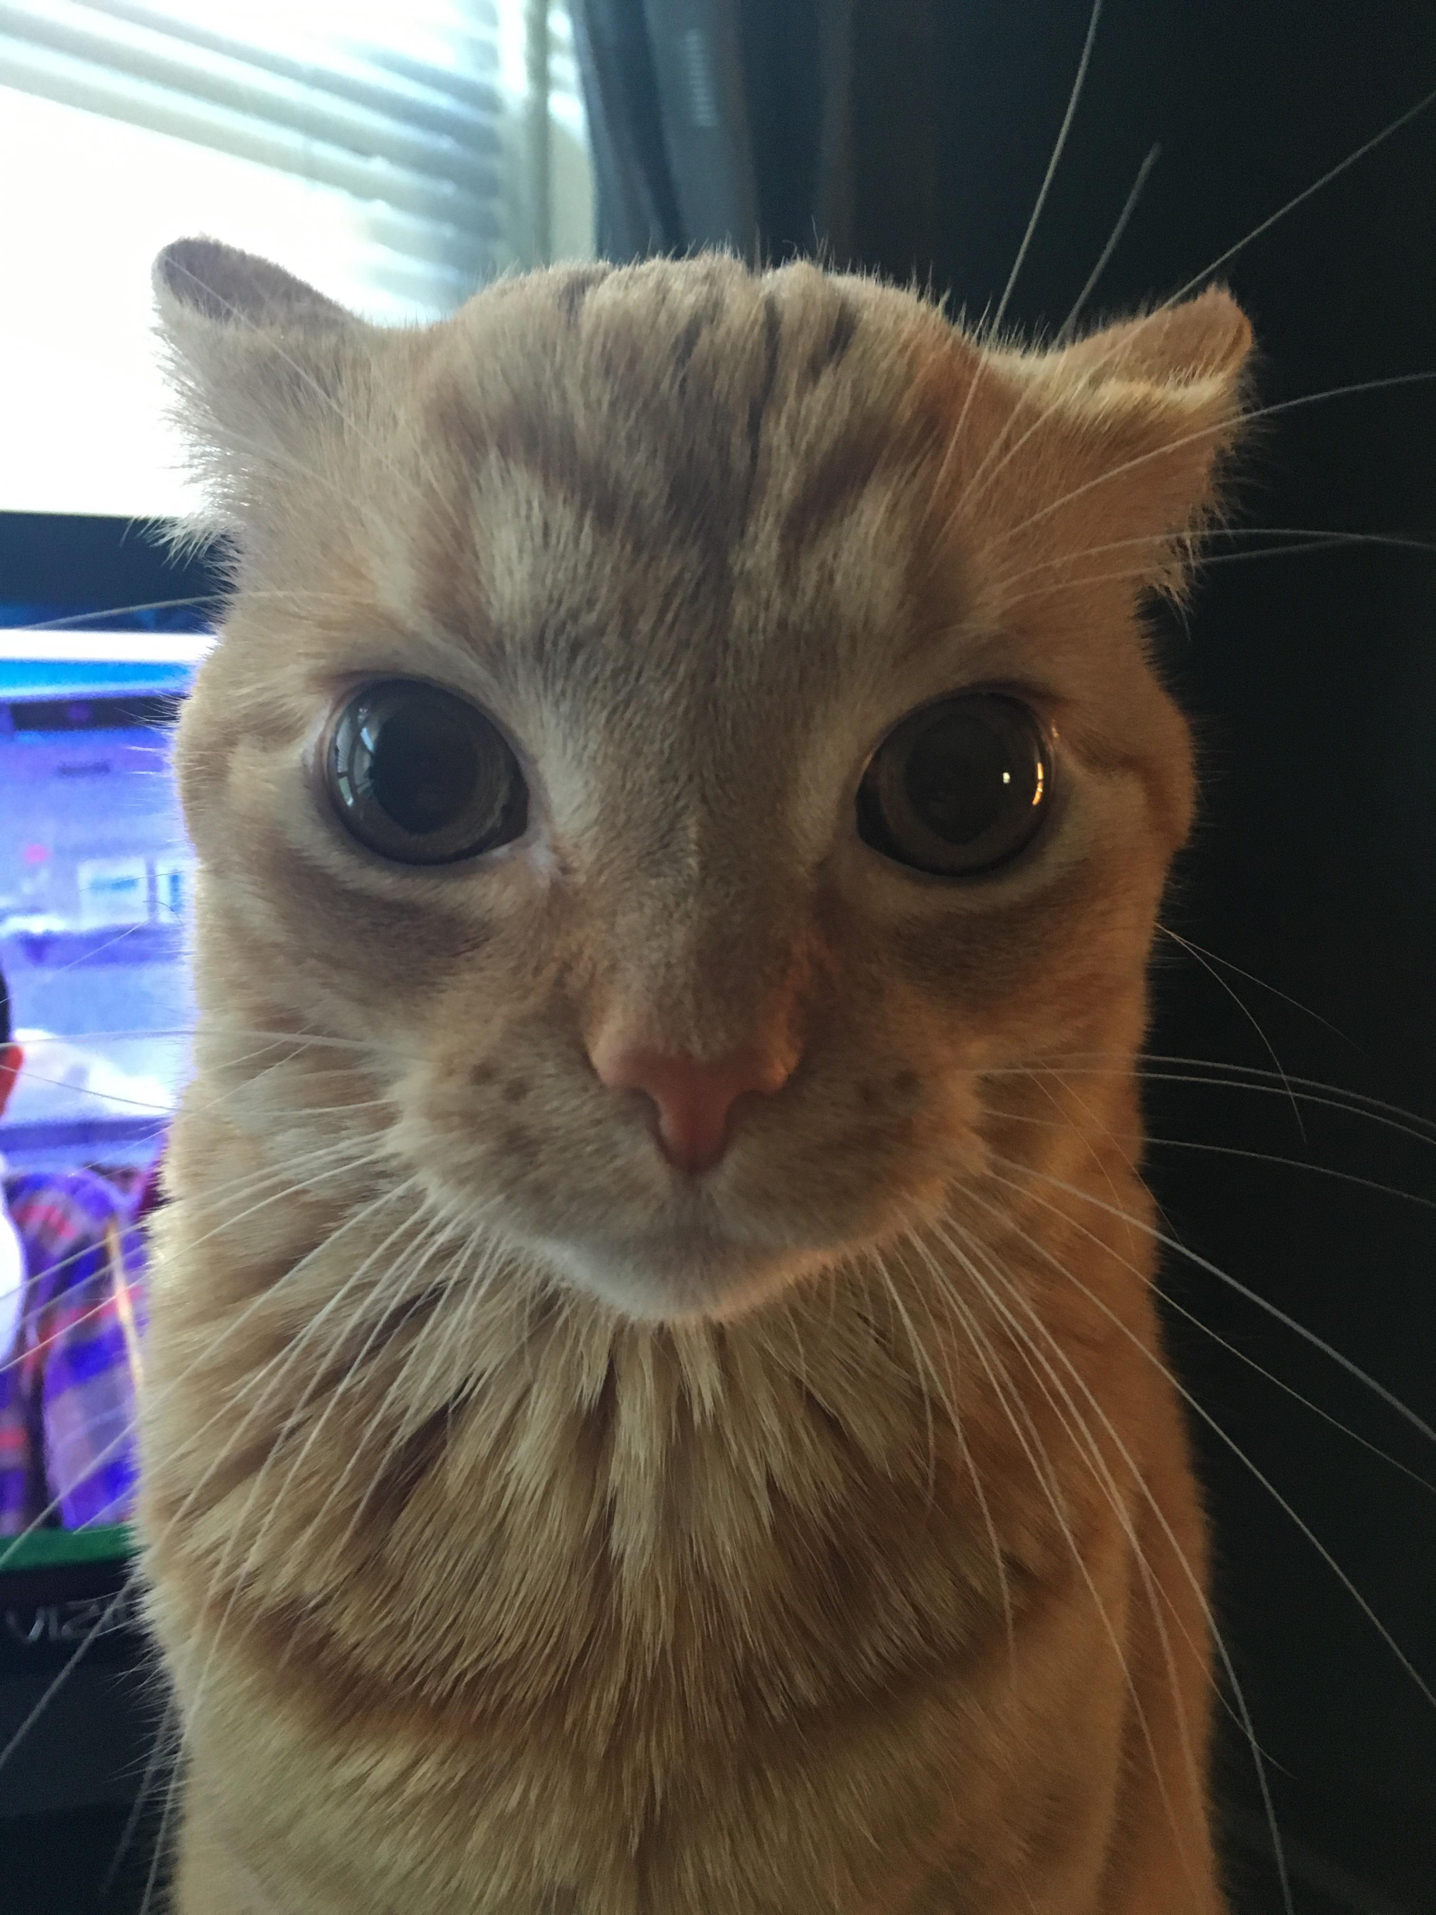
Who we are / What we Do
Mentor
Teach a variety of cybersecurity topics
Empower students with technical and non-technical skills
Hands-on time to practice
Foster self-learning and continual improvement
Cultivate community of talented individuals
Compete
Represent Penn State in cyber competitions
Travel to competitions and conferences
Network and build your resume
Notes:
Josh

Slide 4

Learning Objectives:
What is incident response?
IR during competitions
Useful tools
Practice/Example time!

Slide 5
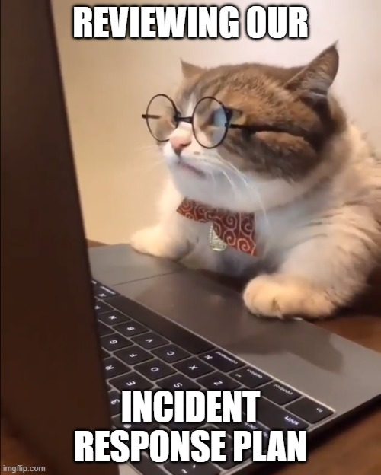
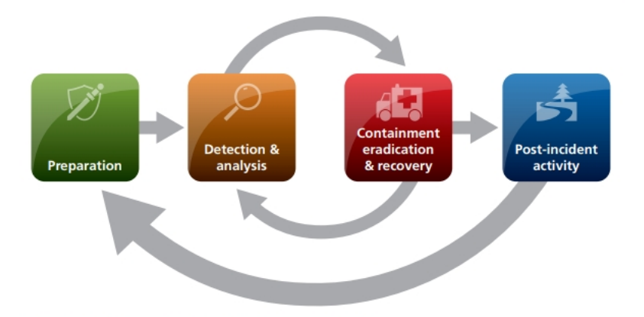
What is Incident Response?
The way an organization reacts to a cyberattack or security event
Usually broken down into before, during, and after the incident
NIST incident response life cycle:

Slide 6

Why IR is important
Provides a coherent procedure to follow in the event of an incident
People panic when things go wrong
Extremely important to business continuity
How can we quickly get things running again?
How does this affect daily operations?

Slide 7

Competition vs Reality
Very quick process
Have to keep systems up
Usually need to gather evidence before taking decisive action
Less tools/resources

Slide 8

IR Plan during competitions
1. Alert your team 2. Gather initial evidence 3. Take action; boot them 4. Gather additional evidence 5. Communicate evidence to report writer

Slide 9

Noticing an Incident
Competition attackers ramp slowly
Initial access may not be noticeable
Misconfigurations
Bad creds
Actions become more apparent later in the comp
Defacement
New users
Configuration changes
Overt messaging

Slide 10
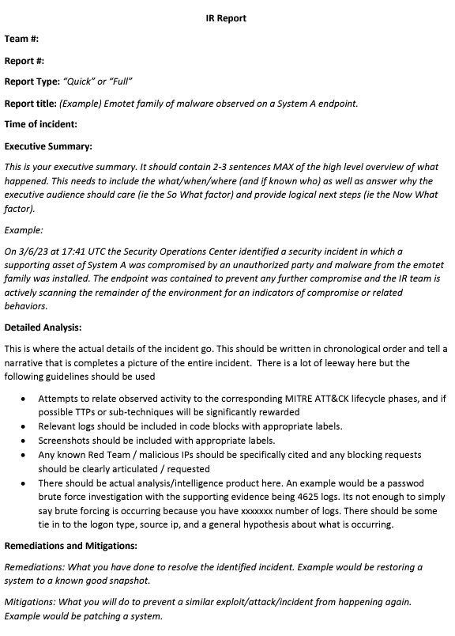
What we need
Who
What
When
Where
How
Actions taken
Requested actions

Slide 11
Windows Tools
SysInternals Suite – Lots of useful utilities
`query user` find logged in users
`netstat –b –n` Connections and binaries
Powershell Transcripts – Command Logs
Event Log!!! + ProcMon

Slide 12
Linux Tools
`ps –awfux` Process tree
`netstat –tpna` Connections + details
`w`/`who –a` Currently logged in users
Check bash history for logged commands
Check /var/log
/var/log/auth.log

Slide 13
Example 1
Our server’s admin creds were weak and guessed by an attacker
They log into our machine; how can we gather evidence and act?

Slide 14
Example 2
The attacker leverages their previous access to setup some malicious scripts/binaries
They might perform some other kinds of mischief
How can we find out specifically what they did?

